Slide 1
Neuro muscular Transmission
Dr RESHMY K.R
Prof & Head
Dept of Physiology & Biochemistry

Slide 2
The junction between terminal branch of the nerve fiber and muscle fiber.
The transfer of information from motor nerve ending to the muscle fiber through neuromuscular junction is called neuromuscular transmission.

Slide 3
Motor End Plate forms the postsynaptic part of NMJ. It is the thickened portion of the muscle plasma membrane (sarcolemma) that is folded to form depressions called junctional folds.
The terminal nerve endings do not penetrate the motor endplate but fit into the junctional folds. Junctional folds have nicotinic ACh receptors concentrated at the top. These receptors are ACh gated ion channels.

Slide 8
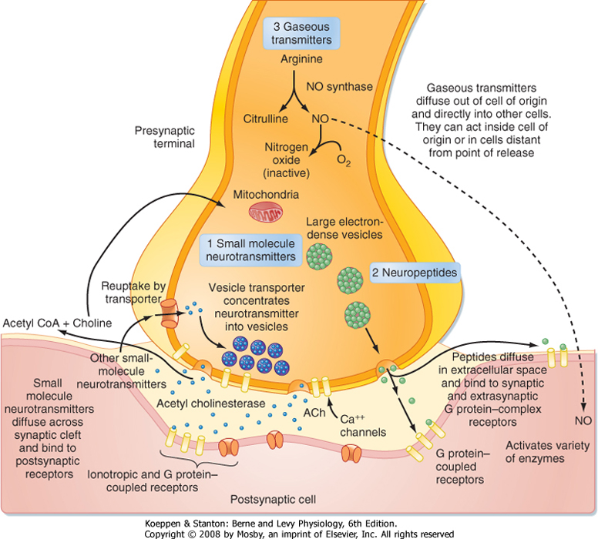

Slide 9
Transmission
ACh is synthesized in the pre-synaptic terminal using choline and acetyl-CoA and the enzyme choline acetyltransferase.
It subsequently goes through a series of modifications before being packaged in vesicles.
Upon depolarization, an action potential travels down the axon, causing voltage-gated calcium channels to open, resulting in an influx of calcium ions into the nerve terminal.
This causes the vesicles to migrate towards the nerve terminal membrane and fuse with the active zones.

Slide 10
Different vesicular (SNAP-25, syntaxin) and nerve terminal membrane proteins (synaptobrevin and synaptotagmin) play a role in the fusion of SVs to active zones and exocytosis of ACh into the synaptic cleft.
The released ACh subsequently binds to nicotinic ACh receptors on the junctional folds of the motor endplate.
The binding of ACh to receptors triggers the opening of ACh gated ion channels that allow the influx of sodium ions into the muscle.
The sodium influx changes the postsynaptic membrane potential from -90 mV to -45 mV.

Slide 11
This decrease in membrane potential is called endplate potential.
In the NMJ, endplate potential is strong enough to propagate action potential over the surface of the skeletal muscle membrane that ultimately results in muscle contraction.
To prevent sustained depolarization and muscle contraction, as well as to allow for repolarization, ACh is metabolized by acetylcholinesterase into its subunits, choline, and acetate.
Choline can then be re-used for the synthesis of ACh

Slide 12
Overview of Events at the neuromuscular junction
An action potential (AP), an electrical impulse, travels down the axon of the motor neuron to the end bulbs (synaptic terminals)
The AP causes the synaptic vesicles to fuse with the end bulb membrane, resulting in the release of Acetylcholine (Ach) into the synaptic cleft
Ach diffuses across the synaptic cleft & binds to Ach receptors on the motor end plate
The binding of Ach to its receptors causes a new AP to be generated along the muscle cell membrane
Immediately after it binds to its receptors, Ach will be broken down by Acetylcholinesterase (AchE) – an enzyme present in the synaptic cleft

